Slide 1


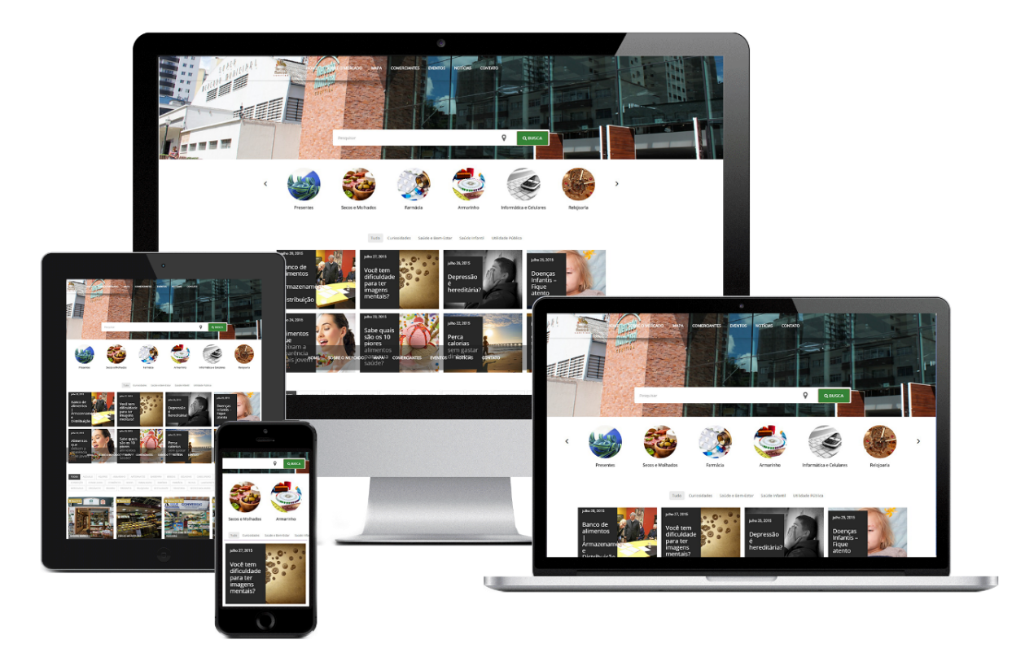

Responsive Design
Sites that Adapt to Different Devices
Responsive Web Sites
SoftUni Team
Technical Trainers
Software University
http://softuni.bg

Slide 2
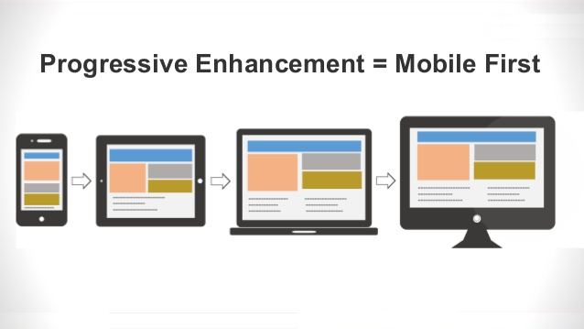
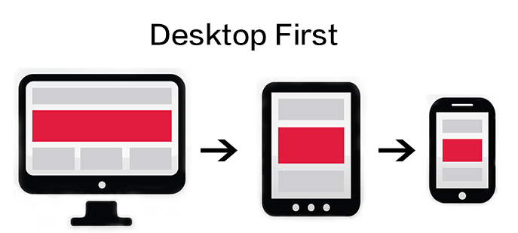
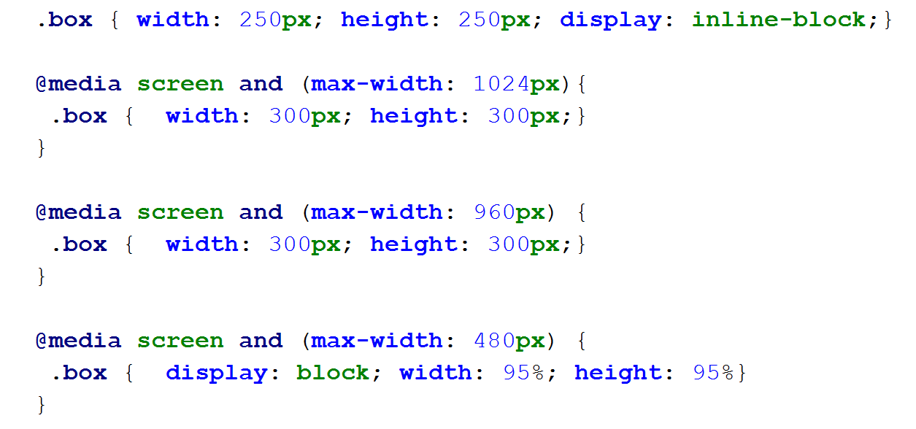
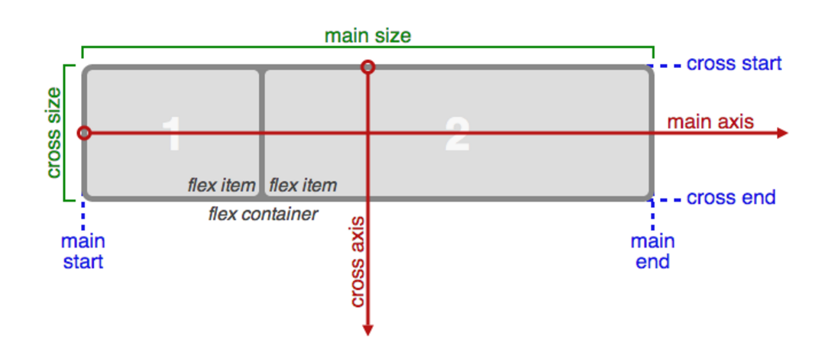
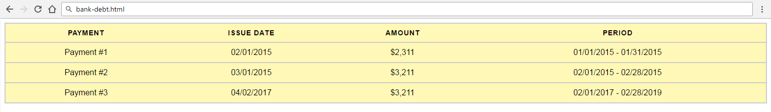
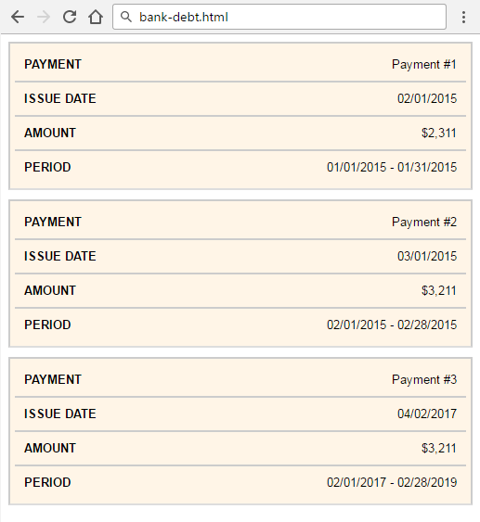
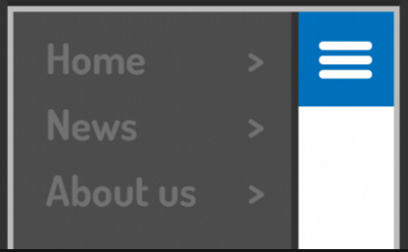
Table of Contents
Mobile First
Desktop First
Media Queries
Flex Layout (Flexbox)
Flexible Images
Flexible Forms
Flexible Tables
Flexible Navigation Menus

Slide 3
Have a Question?
sli.do #front-end

Slide 4

Responsive Design
Overview

Slide 5
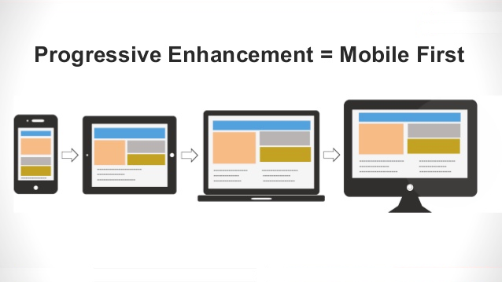
Mobile First Design

Slide 6
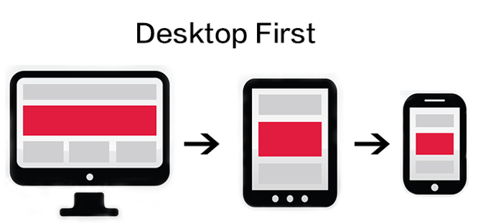
Desktop First Design

Slide 7
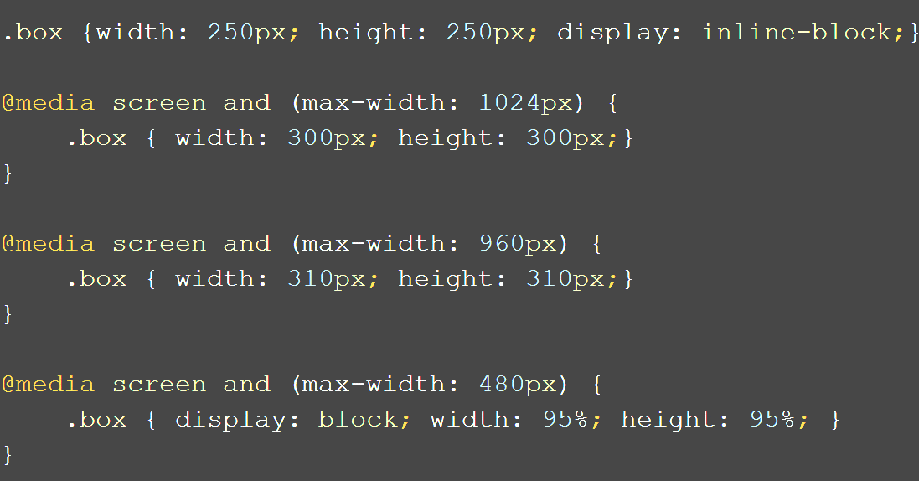
Media Queries
Creating Responsive design with CSS

Slide 8
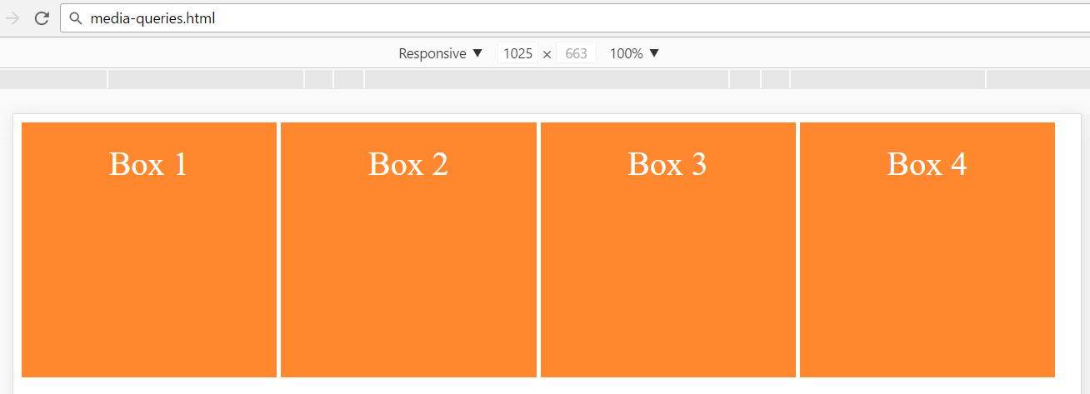
Media Queries
.box {
display: inline-block;
background: #ff882e;
text-align: center;
line-height: 2.5em;
color: #ffffff;
font-size: 2em;
width: 245px;
height: 245px;
}
<div class="box">Box 1</div>
<div class="box">Box 2</div>
<div class="box">Box 3</div>
<div class="box">Box 4</div>

Slide 9
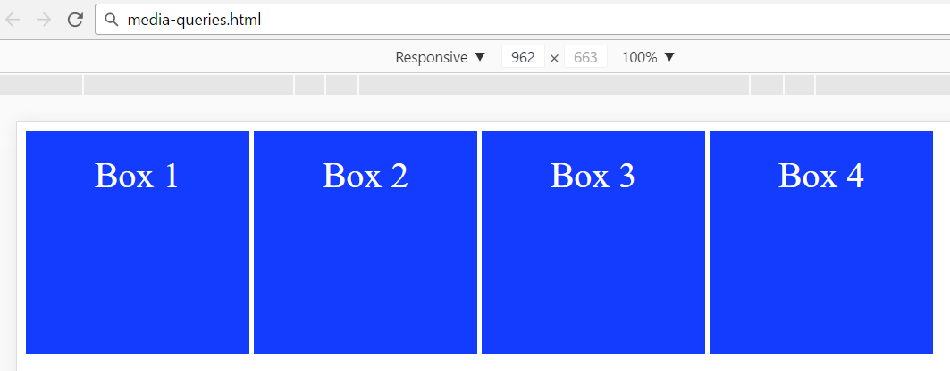
Media Queries: Width < 1024px
@media screen and (max-width: 1024px) {
.box {
width: 200px;
height: 200px;
background: #143cff;
}
}

Slide 10
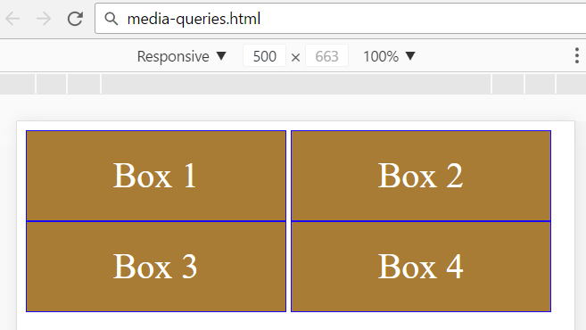
Media Queries: Width < 960px
@media screen and (max-width: 960px) {
.box {
width: calc(50% - 10px);
border: 1px solid #1907ff;
background: #a97c36;
height: 80px;
}
}

Slide 11
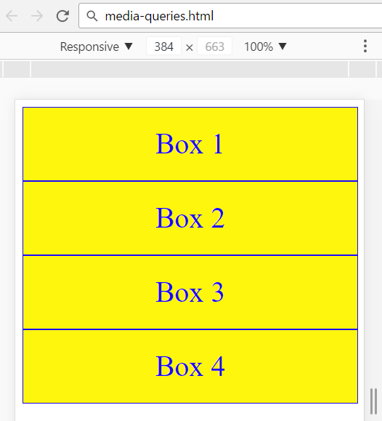
Media Queries: Width < 480px
@media screen and (max-width: 480px) {
.box {
display: block;
width: 100%;
background: #fff60e;
color: #1907ff;
}
}

Slide 12



Typical Resolutions to Consider
Width ≥ 1024px
Desktops / laptops
640px ≤ width < 1023px
Tablets
Width < 640px
Smartphone
/* Normal CSS for
desktops / laptops */
{ … }
@media screen and
(max-width: 1024px)
{ … }
@media screen and
(max-width: 640px)
{ … }

Slide 13
Flexbox
display: flex
Flexible Layout in CSS

Slide 14
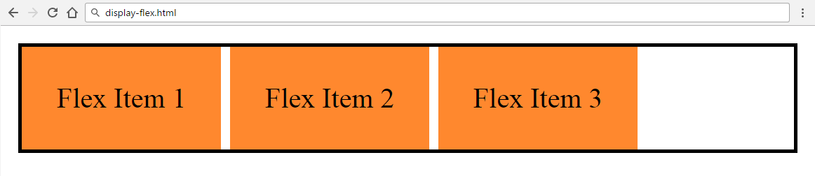
Flex Container Properties: Flex
<div class="flex-container">
<div class="flex-item">Flex Item 1</div>
<div class="flex-item">Flex Item 2</div>
<div class="flex-item">Flex Item 3</div>
</div>
.flex-container {
display: flex;
border: 2px solid black;
}
.flex-item {
margin-right: 5px;
padding: 20px;
background: #ff882e; }

Slide 15
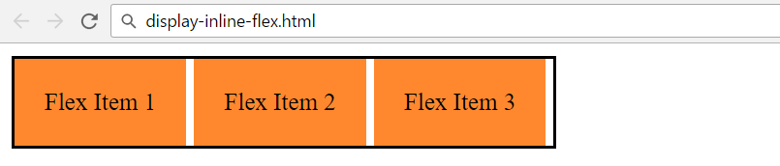
Flex Container Properties: Inline Flex
<div class="flex-container">
<div class="flex-item">Flex Item 1</div>
<div class="flex-item">Flex Item 2</div>
<div class="flex-item">Flex Item 3</div>
</div>
.flex-container {
display: inline-flex;
border: 2px solid black;
}
.flex-item {
margin-right: 5px;
padding: 20px;
background: #ff882e; }

Slide 16

Flex Container Properties: Flex Direction
flex-direction: row
flex-direction: row-reverse
flex-direction: column
flex-direction: column-reverse

Slide 17
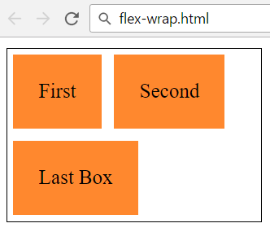
Flex Container Properties: Flex Wrap
<div class="flex-container">
<div class="flex-item">First</div>
<div class="flex-item">Second</div>
<div class="flex-item">Last Box</div>
</div>
flex-wrap:
no-wrap / wrap /
wrap-reverse
.flex-container {
display: flex;
flex-wrap: wrap;
width: 200px;
border: 1px solid black;
}
.flex-item {
margin: 5px;
padding: 20px;
background: #ff882e;
}

Slide 18
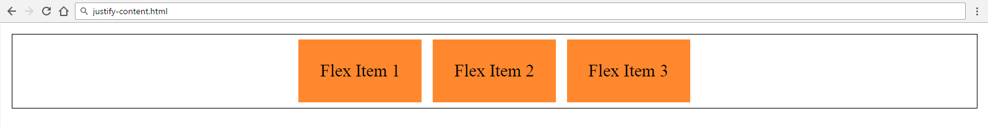
Flex Container Properties: Justify Content
<div class="flex-container">
<div class="flex-item">Flex Item 1</div>
<div class="flex-item">Flex Item 2</div>
<div class="flex-item">Flex Item 3</div></div>
Align along the main axis
.flex-container {
display: flex;
justify-content: center;
border: 1px solid black;
margin: 10px; }
.flex-item {
margin: 5px;
padding: 20px;
background: #ff882e;
}

Slide 19
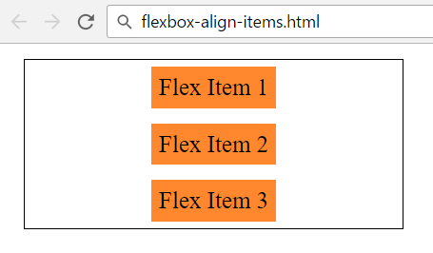
Flex Container Properties: Align Items
<div class="flex-container">
<div class="flex-item">Flex Item</div>
<div class="flex-item">Flex Item</div>
<div class="flex-item">Flex Item</div>
</div>
Align along the cross axis
.flex-container {
display: flex;
align-items: center;
flex-direction: column;
border: 1px solid black;
margin: 10px; }
.flex-item
{
margin: 5px;
padding: 20px;
background: #ff882e;
}

Slide 20
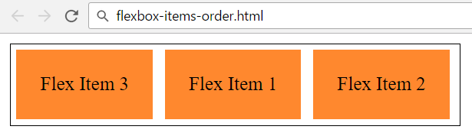
Children Flexbox Properties: Order
<div class="flex-container">
<div class="flex-item flex-item01">Flex Item 1</div>
<div class="flex-item flex-item02">Flex Item 2</div>
<div class="flex-item flex-item03">Flex Item 3</div>
</div>
.flex-container {
border: 1px solid black;
display: flex;
}
.flex-item {
margin: 5px;
padding: 20px;
background: #ff882e; }
.flex-item01 { order: 2; }
.flex-item02 { order: 3; }
order: 0
order: 2
order: 3

Slide 21
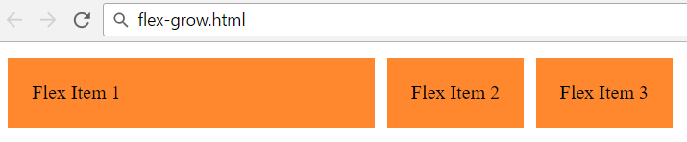
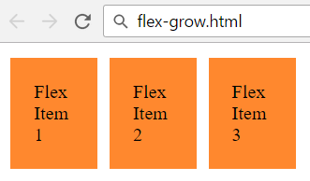
Children Properties: Grow and Shrink
<div class="flex-container">
<div class="flex-item flex-item01">Flex Item 1</div>
<div class="flex-item flex-item02">Flex Item 2</div>
<div class="flex-item flex-item03">Flex Item 3</div></div>
.flex-container {
display: flex;
border: 1px solid black;
}
.flex-item {
margin: 5px;
padding: 20px;
background: #ff882e; }
.flex-item01 {
flex-grow: 1;
}

Slide 22
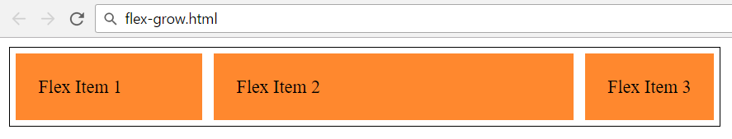
Children Properties: Grow and Shrink
<div class="flex-container">
<div class="flex-item flex-item01">Flex Item 1</div>
<div class="flex-item flex-item02">Flex Item 2</div>
<div class="flex-item flex-item03">Flex Item 3</div></div>
.flex-container {
display: flex;
border: 1px solid black;
}
Take 80% of the spare space
Take 20% of the spare space
.flex-item {
margin: 5px;
padding: 20px;
background: #ff882e; }
.flex-item01 { flex-grow: 20; }
.flex-item02 { flex-grow: 80; }
.flex-item03 { flex-grow: 0; }

Slide 23
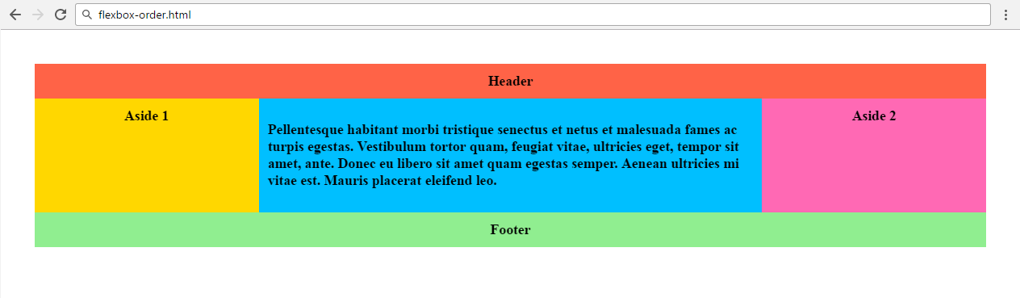
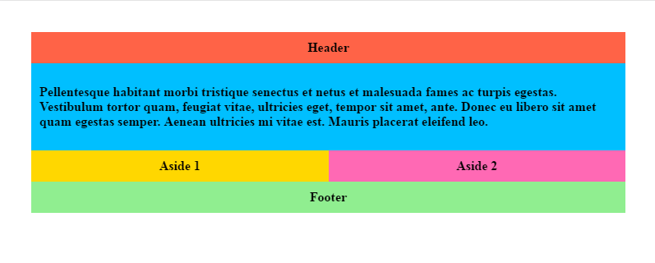
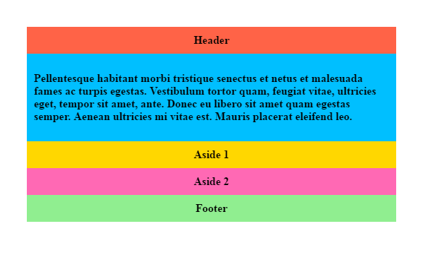
Problem: FlexBox Order
You are given the HTML file for a Web site
Write the CSS and media queries
at 800px
at 600px
width ≥ 800px
600px ≤ width < 800px
width < 600px
Hint: https://css-tricks.com/snippets/css/a-guide-to-flexbox/#flexbox-examples

Slide 24
Solution: FlexBox Order HTML
<header class="header">Header</header>
<article class="main-article">
<p>Pellentesque habitant…</p>
</article>
<aside class="aside aside-1">Aside 1</aside>
<aside class="aside aside-2">Aside 2</aside>
<footer class="footer">Footer</footer>

Slide 25
Solution: FlexBox Order CSS
body {
display: flex;
flex-flow: row wrap;
font-weight: bold;
text-align: center;
padding: 30px; }
body > * {
padding: 10px;
flex: 1 100%; }
.header {
background: tomato;
}
.main-article {
text-align: left;
background:deepskyblue;
}
.aside-1 {
background: gold;
}
.aside-2 {
background: hotpink; }
.footer {
background: lightgreen;
}

Slide 26
Solution: FlexBox Order
@media all and (min-width: 800px) {
.main-article { flex: 3 0; }
.aside-1 { order: 1; }
.main-article { order: 2; }
.aside-2 { order: 3; }
.footer { order: 4; }
}
@media all and (min-width: 600px) {
.aside { flex: 1 0; }
}
flex-basis (initial main size)
flex-grow

Slide 27

Flexible Images
Making image elements - Responsive

Slide 28
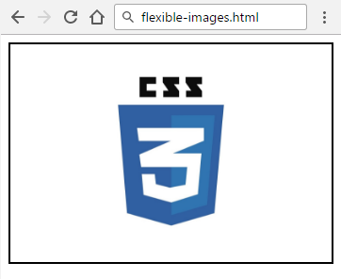
Flexible Images: Use "max-width"
<div class="image-container">
<img src="Logo-CSS3.jpg" alt="css-logo">
</div>
.image-container {
border: 2px solid black;
}
img {
max-width: 100%;
height: auto;
}
max-width overrides the width property

Slide 29
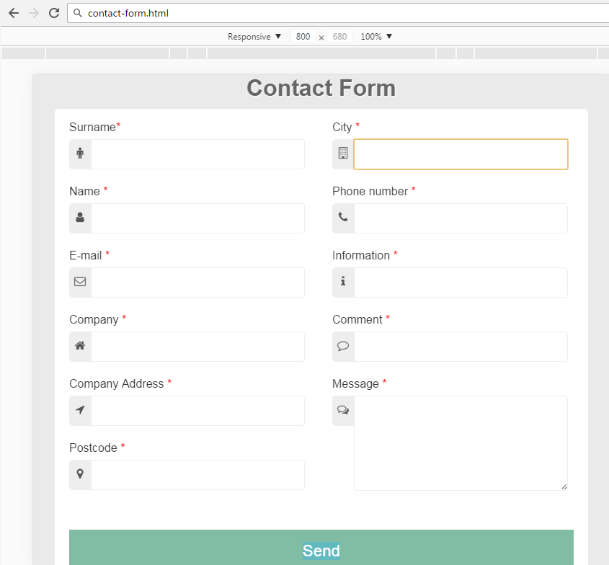
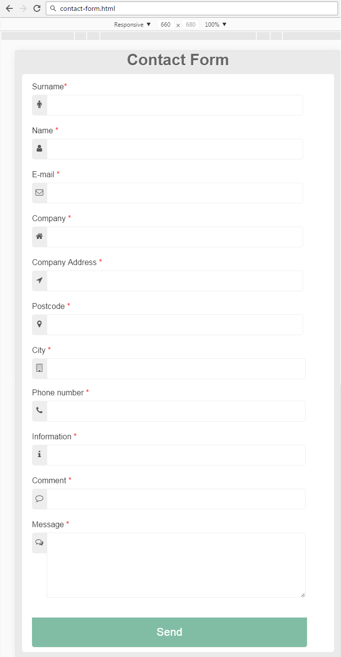
Responsive Forms
Making Form elements - Responsive

Slide 30
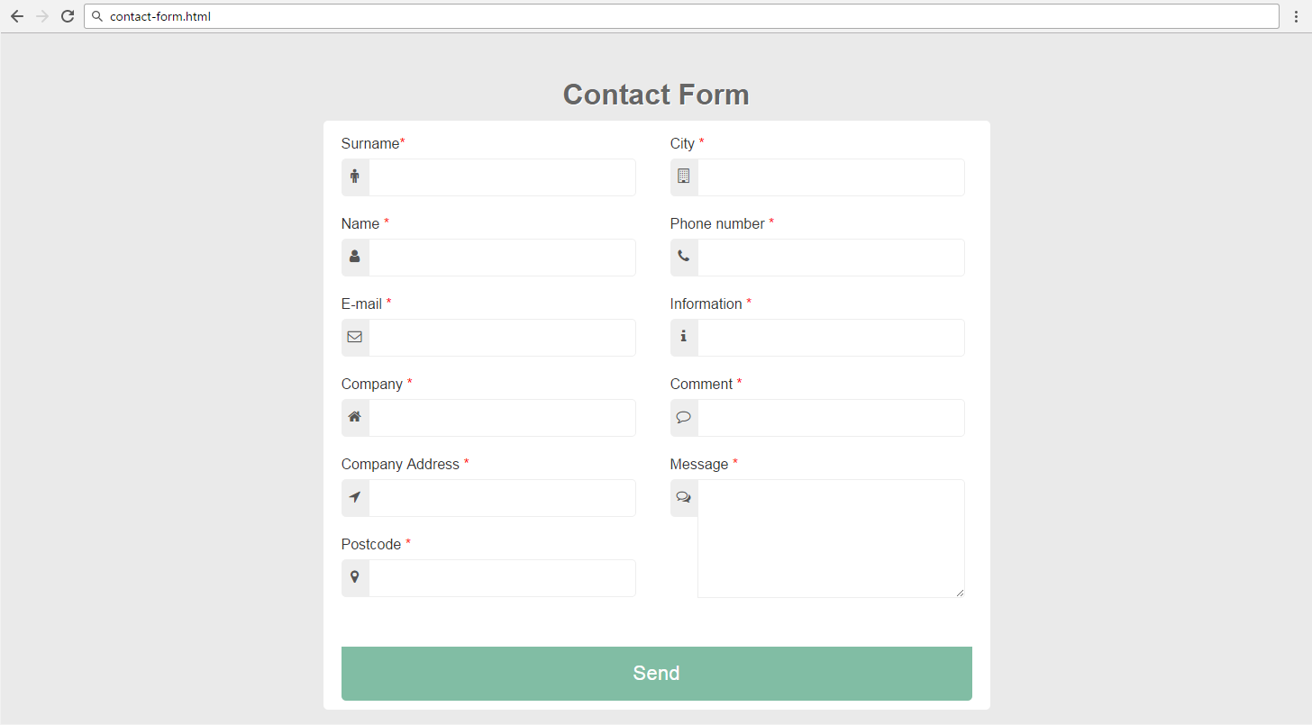
Problem: Contact Form
You are given the HTML file and CSS file
Write the missing media queries
at 660px
at 800px

Slide 31
Solution: Contact Form (HTML + CSS)
<form>
<div class="left-contact">…</div>
<div class="right-contact">…</div>
<button class="button-contact">Send</button>
</form>
form { padding: 10px 20px; }
.left-contact {
float: left;
width: 50%;
box-sizing: border-box;
}
.right-contact {
float: right;
width: 50%;
box-sizing: border-box;
}

Slide 32
Solution: Contact Form
@media all and (max-width: 800px) {
form {
max-width: calc(100% - 40px);
}
}
@media all and (max-width: 660px) {
.left-contact, .right-contact {
width: 100%;
padding: 0;
}
}

Slide 33
Solution: Contact Form (2)
@media all and (max-width: 600px)
.right-contact input {
width: calc(100% - 70px);
}
textarea {
width: calc(100% - 100px);
}
.button-contact {
width: calc(100% - 35px);
}
}

Slide 34
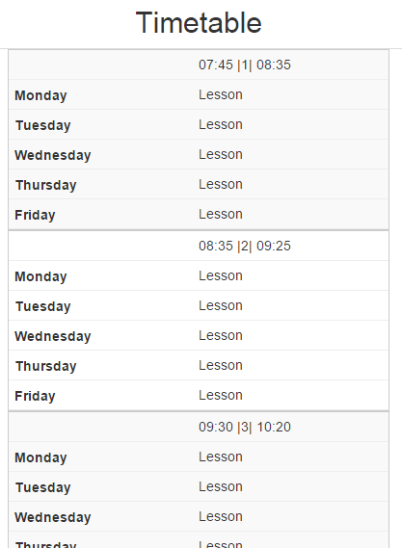
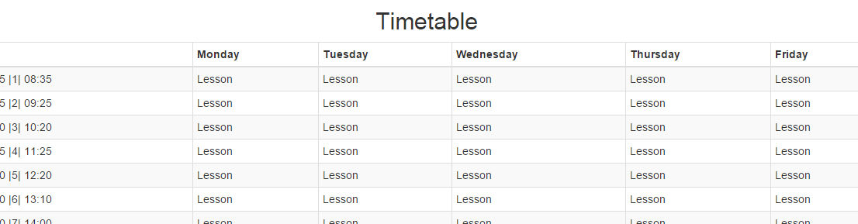
Flexible Tables
Making tables - Responsive

Slide 35
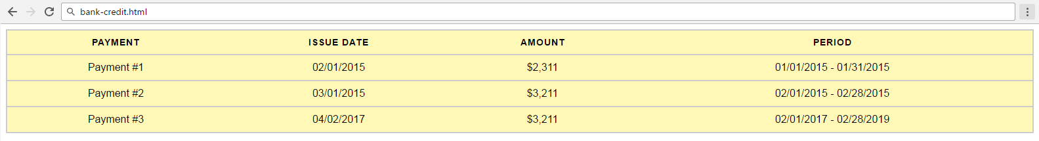
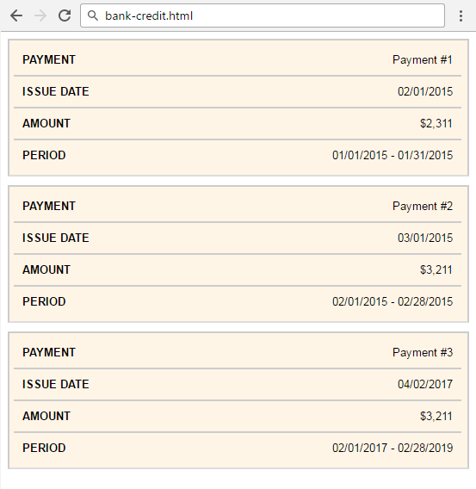
Problem: Bank Credit
You are given the HTML file:
Make the HTML table responsive like at the screenshot on the right
Add media query at max-width: 600px

Slide 36
Solution: Bank Credit (HTML)
<!--TODO: Create Table-->
<thead>
<tr>
<th>Payment</th>
<th>Issue Date</th>
<th>Amount</th>
<th>Period</th>
</tr></thead>
<tbody><tr>
<td data-label="Payment">Payment #1</td>
<td data-label="Issue Date">02/01/2015</td>
<td data-label="Amount">$2,311</td>
<td data-label="Period">01/01/2015 - 01/31/2015</td>
</tr></tbody>

Slide 37
Solution: Bank Credit (CSS)
body {
font-family: ‘Arial’, serif;
}
table {
border: 1px solid #ccc;
width: 100%;
margin: 0;
padding: 0;
border-collapse: collapse;
border-spacing: 0;
}
table tr {
border: 2px solid #ccc;
padding: 5px;
background: #fff8b7; }
table th, table td {
padding: 10px;
text-align: center; }
table th {
text-transform: uppercase;
font-size: 14px;
letter-spacing: 1px;
}

Slide 38
Solution: Bank Credit (CSS) (2)
@media screen and (max-width:600px) {
table {
border: 0;
}
thead tr {
position: absolute;
top: -9999px;
left: -9999px;
}
table tr {
margin-bottom: 10px;
display: block;
border-bottom: 2px solid #ddd;
background: #fff5e7;
}
table td::before {
content: attr(data-label);
float: left;
text-transform: uppercase;
font-weight: bold;
}
table td {
display: block;
text-align: right;
font-size: 13px;
border-bottom: 2px solid #ccc;
}
table td:last-child {
border-bottom: 0;
} }

Slide 39
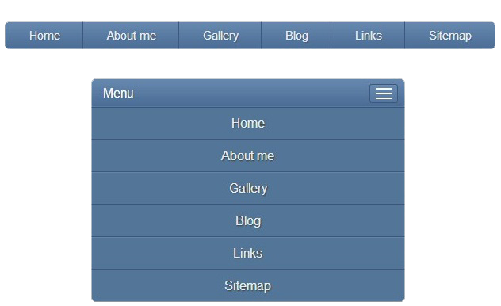
Responsive Navigation Menu
Making Navigation Menu - Responsive

Slide 40



Problem: HR Company

Slide 41
Solution: HR Company
@media all and (max-width: 880px) {
.business {
display: block;
}
.learn-more {
display: block;
margin-bottom: 25px;
}
.business article {
text-align: center;
}
main h2 { font-size: 1.4em; }
.top-list {
display: none;
height: auto; }
}
article p {
max-width: 100%;
}
#menu-icon {
display: inline-block;
}
nav li {
text-align: center;
width: 100%;
padding: 10px 0;
margin: 0;
background: #f6f6f6;
}
nav:hover ul.top-list {
display: block;
}

Slide 42


ViewPort
Very Important for Mobile Sites
<meta name="viewport" content="width=device-width, initial-scale=1.0">

Slide 43

Summary
Summary
Media queries allow different CSS for different screen sizes
Flexbox is very powerful!
@media screen and (max-width: 640px) {
.box { display: block }
}
.flex-container {
display: flex;
flex-wrap: wrap;
}

Slide 44







Web Fundamentals – Course Introduction
https://softuni.bg/courses/web-fundamentals-html5

Slide 45






SoftUni Diamond Partners

Slide 46






SoftUni Diamond Partners

Slide 47
License
This course (slides, examples, demos, videos, homework, etc.) is licensed under the "Creative Commons Attribution-NonCommercial-ShareAlike 4.0 International" license

Slide 48





Trainings @ Software University (SoftUni)
Software University – High-Quality Education, Profession and Job for Software Developers
softuni.bg
Software University Foundation
http://softuni.foundation/
Software University @ Facebook
facebook.com/SoftwareUniversity
Software University Forums
forum.softuni.bg

